Slide 1
Product’s presentation
Presenter: Md. Tahseen Anam

Slide 2
About
English to Bangla dictionary software.
English to Bangla translation.
Works in offline.
On screen selection.
No need to type the word or search the word each time.
Both Windows desktop and Android version is available.

Slide 3
Development works in progress
Integrating the translation algorithm in the software.
Developing the translation algorithm.
Increasing dataset.
Detecting spelling mistakes.
Showing more information for a word.

Slide 4
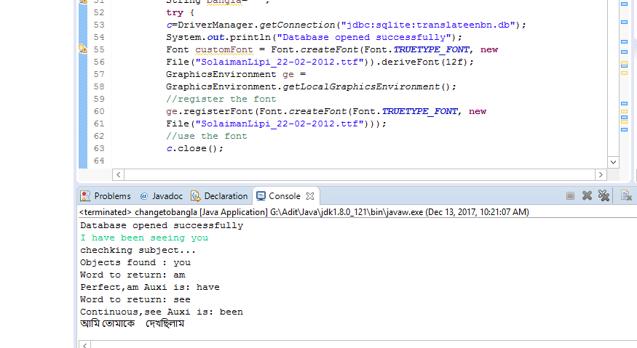
Translation

Slide 5
Business Scope
No good dictionary software.
No good offline English to Bengali translation software.
Existing dictionary software are not informative.

Slide 6
Thank You

